Slide 1



FlexFunction2Sustain
Open Innovation Ecosystem for Sustainable Nano-Functionalized Plastic and Paper Surfaces and Membranes

Slide 2
What is an Open Innovation Test Bed?
Innovative products
Novel Strategies for Financing
Innovation = „New Ideas and creative thoughts in devices and methods“
in Business World:
Transform novel ideas and inventions to economic success
Novel manufacturing methods
Novel applications
Novel business models
Advanced Quality control
Open Innovation: Increase innovation potential by partnerships for the innovation process
Open Innovation Test Bed - OITB: Open ecosystem to maximise the innovation potential of novel ideas, technologies, and products
  Network of Suppliers for complementary innovation boosting services
  Single Entry Point: “Realiser for Innovation” as General Contractor and Management Entity for Collective Services

Slide 3
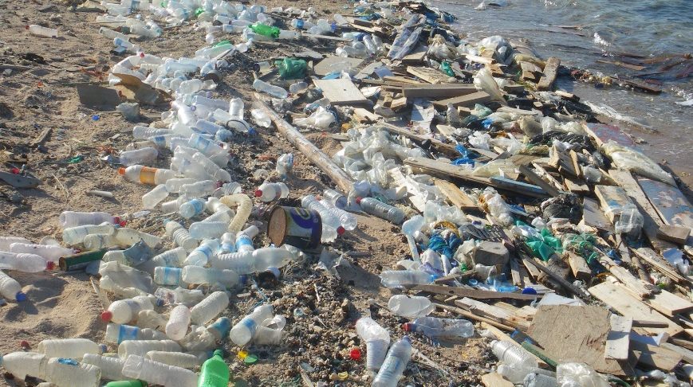

Slide 4
FlexFunction2Sustain will boost innovation for sustainable and smart plastic and paper products
... to drastically reduce plastic waste in the world
... to get products ready for the digital age
making use of
nano-functionalization of novel pastic and paper surfaces

Slide 5
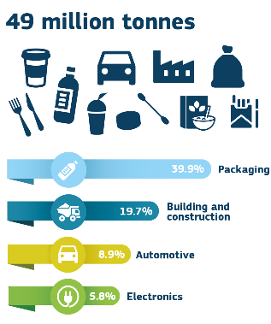
Plastic Waste in Europe
In 2015:
49 000 000 tons plastic demand in EU
25 800 000 tons plastic waste generated in Europe
500 000 tons of plastic waste released to the Ocean every year
source: European Commission: A European Strategy for Plastics in a Circular Economy

Slide 6





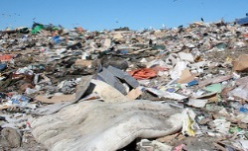
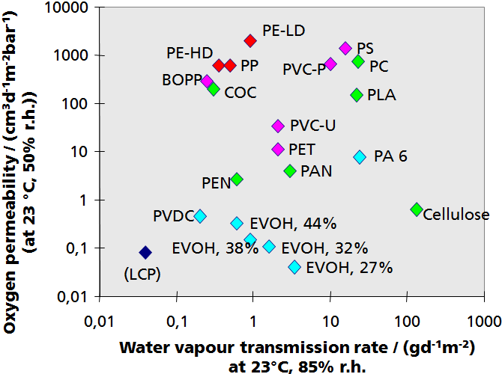
Materials for a circular plastics economy
PET
Cellophane
PBAT
HDPE
Paper
PCL
PVC
PHBO
PBSA
PHBH
PHO
PLA
LDPE
PBS
PP
PS
Packaging today:
  Composite materials such as PE / adhesive / Al / PE)
  Non recyclable; non-degradable
Objective: replace laminates by
  Monomaterial (poly-olefine based)
  Biodegradable plastics
Challenges of such materials
  Insufficient functional properties (gas permeability, etc.)
  Low dimensional stability in processing
  ➔ Surface nano-fuctionalization to regain functional performance

Slide 7

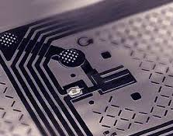
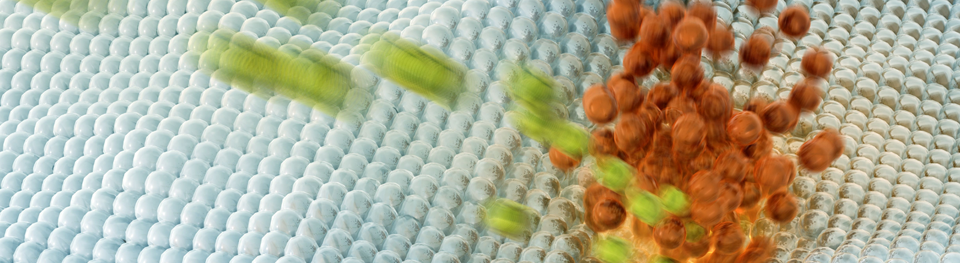
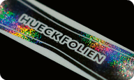
FlexFunction2Sustain OITB Concept
Sustainable innovation services for SME
Sustainable
smart packaging
Plastic and
paper electronics
Surfaces &
membranes
in bio application
Optical films
for security
and design
Validation | Demonstration
Lab-2-fab facilities for development and upscaling
Testing + verification of circularity and safety
Prototyping, piloting and transfer to production
(selective) permeability
bio-functionality
maximized surface area for sensors
Design of materials, surfaces and sustainable products
in-line quality control
antimicrobial
surfaces
mechanical resistance
chemical and corrosion resistance
Electrical conductivity
Electrochemical energy storage
Optical properties
Access to networks
(Bio)polymer webs
Access to customers and supply chains
Paper
Polymer membranes
Access to capital and development funds
Business education
Standardisation and regulation

Slide 8















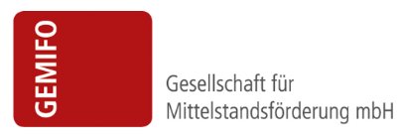
















The FlexFunction2Sustain Ecosystem
OITB Members
Industrial Validation
Potential Clients
External Stakeholders
20 pilot cases
(selected during the project)
Board of Investors and Foundations
External Advisory Board
(Networks, Regulations, Standardisation, and others)

Slide 9
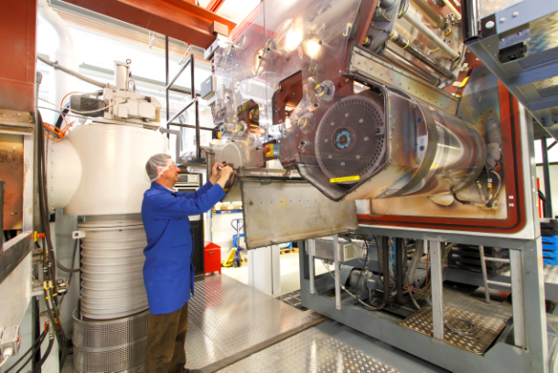
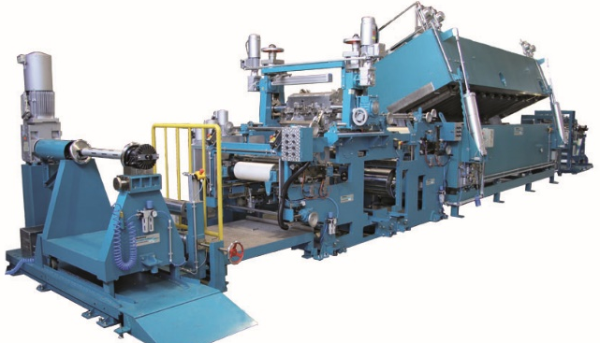
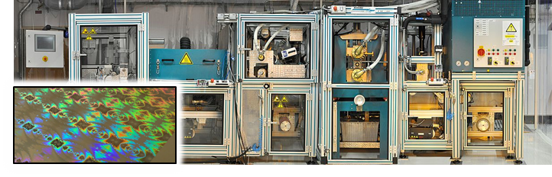
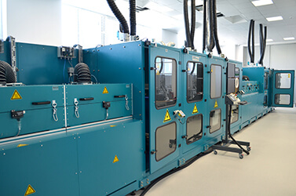
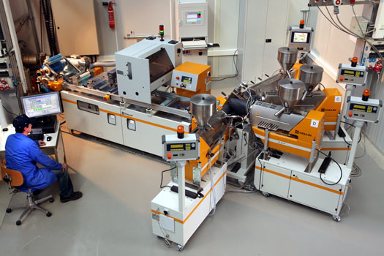

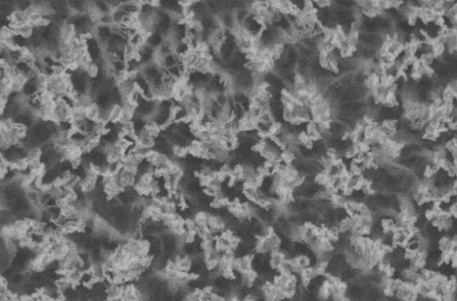
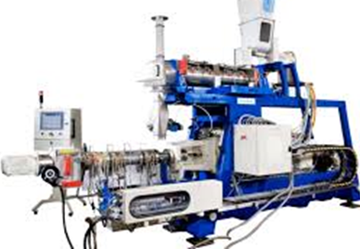
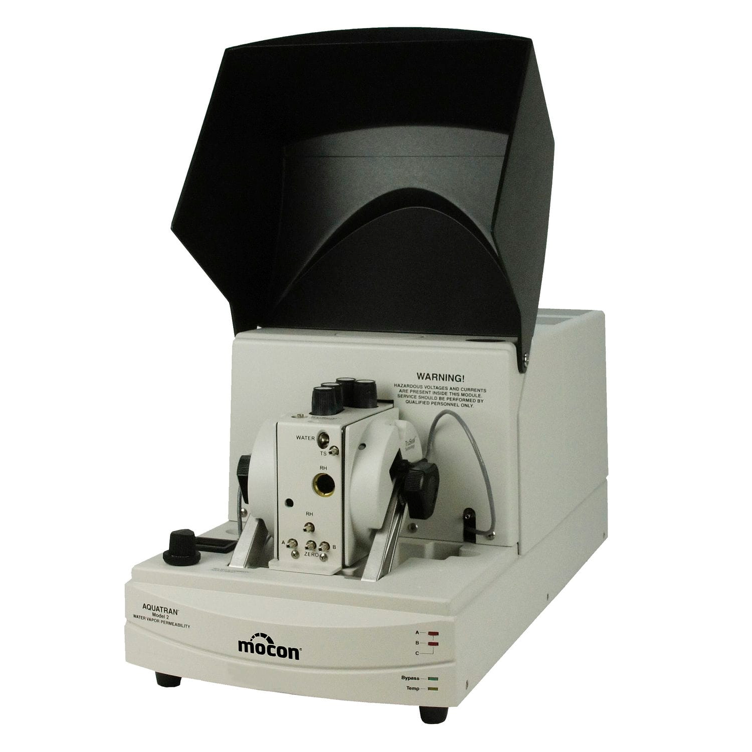

Technical Facilities
Nanofunctionalisation of Surfaces
Atmospheric pressure coating, printing and surface treatment
R2R Vacuum Coating
R2R micro- and nanostructuring
Printed electronics pilot lines
Circularity by Design
Characterisation, Quality Control, Verification
Recycling and Bio-degrability Pilot Lines
Physical and chemical properties
Application Certification
Compounding and Film Extrusion
Functional Performance
Evaluation
Nano-safety assessment

Slide 10
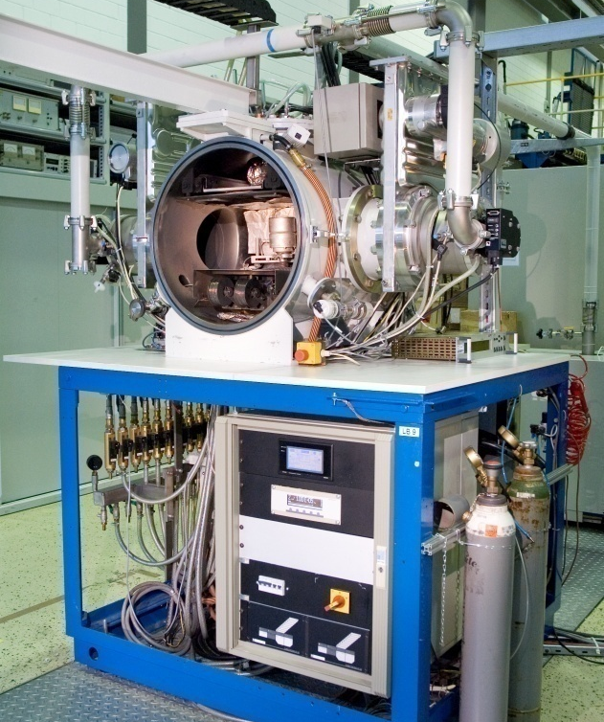
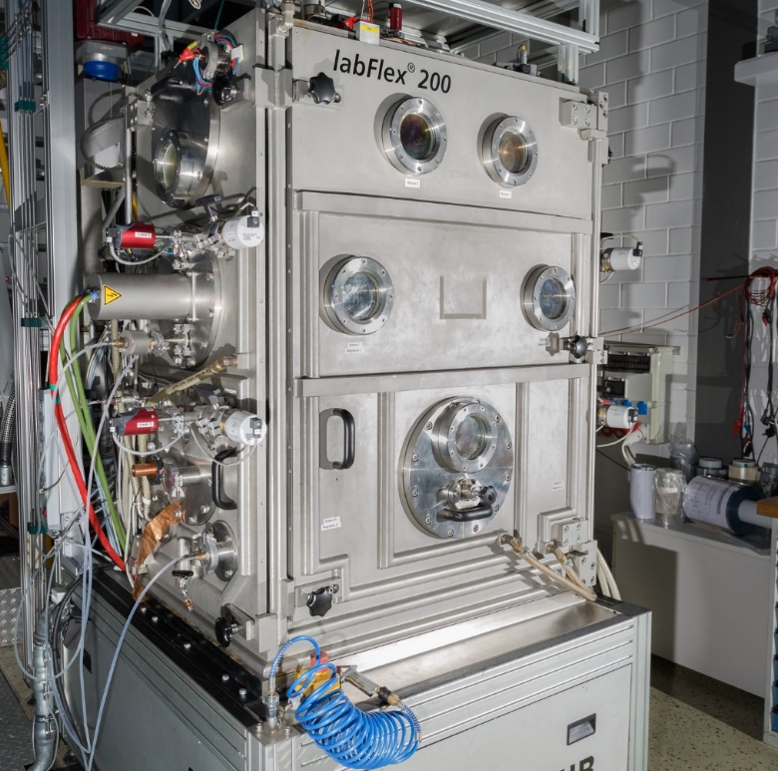
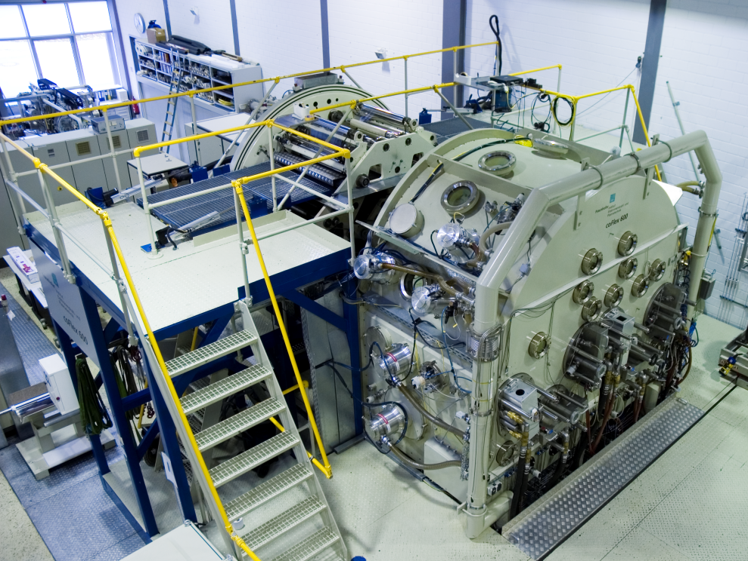
Technical Facilities
TRL4 [FHG-FEP] ➔ TRL5 [FHG-FEP] ➔ TRL6 [FHG-FEP] ➔ TRL7 [AMCOR]
LB9 @ FHG-FEP
labFlex® 200 @ FHG-FEP
coFlex® 600 @ FHG-FEP
Production coater @ AMCOR
A4 Sheets – 1 process
200 mm – 3 stations
650 mm width – 5-6 stations
715 mm … 2000 mm width
Lab-2-Fab approach for all processing facilities ➔ Each process available from TRL 4 to TRL 7+
Facility upgrades target
  (1) Ability to process biopolymers and poly-olefines (2) enhanced productivity and efficiency
  (3) improved reliability and process yield (4) advanced inline quality control

Slide 11
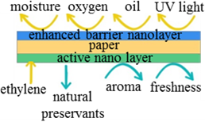



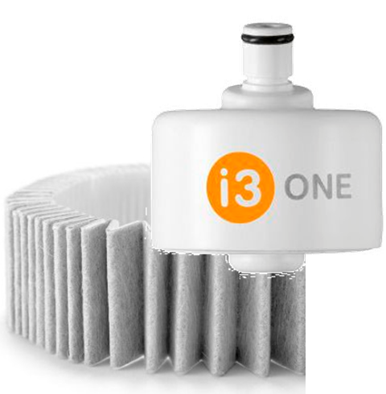
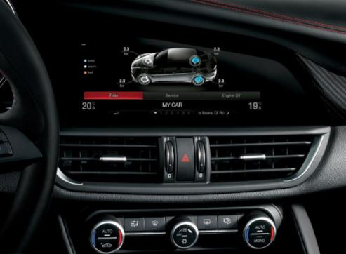
Industrial Use Scenarios
Biodegradable
security labels
Marine degradable
Shampoo sachets
Paper-based fresh food packaging
Innovative plastic
surfaces in cars
Selective and switchable
water filter membranes
Recyclable mono-polymer
drink pouches

Slide 12
Why should I use an OITB ?
Holistic Services from a single contractor (SEP company)
  One contract – multifold services focused on customer needs
  Innovation Services from > 10 EU countries,
  but in your language!
  Renowned experts assemble best-suited,
  “best value for money” services for your innovation
  SEP does all management and progress tracking!
Customer-friendly liability and warranty terms for pilot production
Integrated Business Services, Coaching and Finance Access
  Link to Investors and Access to R&I Funds
  Coaching and consulting on business models and markets
  IPR services and due diligence
(SME) Client
Material Design & Development
Marketing, Customers and Sales
FF2S SEP company
Coaching for approaching Investors
Application testing
(Pilot)Production
Access to innovation funds

Slide 13

Timeline
2024: Sustainable FlexFunction2Sustain OITB Operation
December 2021 and 2022: Competitive Calls for pre-commercial pilot projects
2022: Pilot lines upgraded for biodegradable plastics
and increased productivity and reliability
Early 2021: Single Entry Point company operational
and FlexFunction2Sustain Consortium Member
2020: OITB Member Pilot Facilities accessible for Customer
(direct contracts)

Slide 14
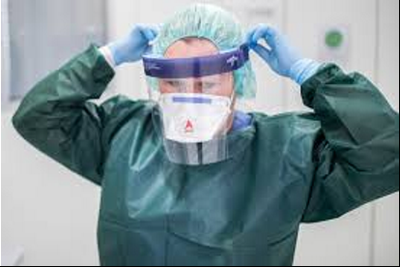
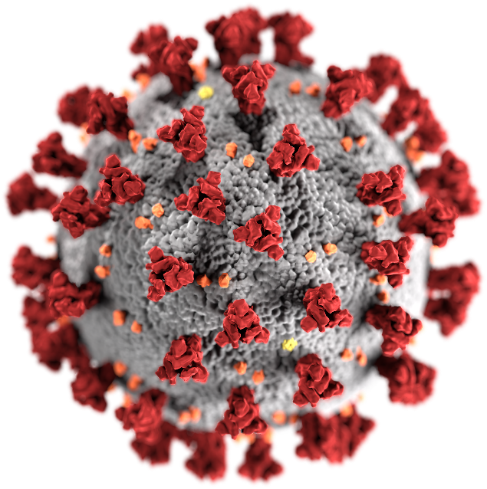
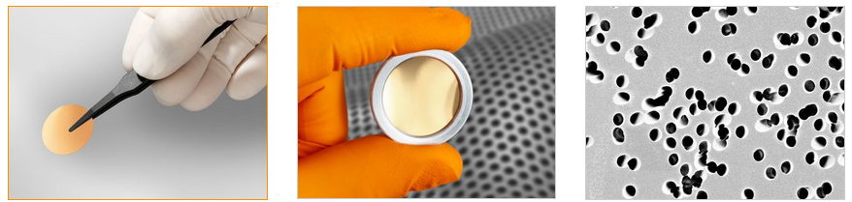
2020 – COVID-19 Epidemic Emergency Response
Anti-Glare Coatings on Plastic Personal Face Shields
Anti-microbial and anti-viral surfaces
  Anti-viral nanoparticle-in-matrix and nano-porous coatings
  ➔ virus-repellent surfaces in public transport
  Nanoimprint Lithography of micro- & nanostructured surfaces
Large-area high-throughput sterilisation of surfaces and medical devices
  With electron beams
  With atmospheric pressure inert or reactive plasma treatment
Metal coated membranes for virus diagnostics in fluids
  Electrically charged membranes for virus accumulation
  ➔ Faster and more reliable diagnostics
Image source: Berliner Zeitung
120 nm
„Viruses are electrically
charged organic nanoparticles“

Slide 15

Thank you very much for listening!
Coordinator Contact
Fraunhofer Institute for Organic Electronics, Electron Beam and Plasma Technology FEP
Dr. rer. nat. John Fahlteich
John.Fahlteich@fep.fraunhofer.de
+49 351 2586 136
www.flexfunction2sustain.eu
This project has received funding from the European Union’s Horizon 2020 research and innovation program under grant agreement No 862156

